Slide 1
Text Analytics using Python

Slide 2
Introduction to Text Analytics
What is Text Analytics ?
What in Natural Language Processing ?
What is Topic Modeling ?
What is LDA ?
Using LDA to do topic modeling
Visualization of results

Slide 3
What is Text Analytics & how does it tie to NLP
Text analytics: Examines large text collections to extract insights and trends. Focuses on quantifiable information like word frequencies, sentiment, and relationships.
Natural language processing (NLP): Enables computers to understand and generate human language. Deals with meaning, grammatical structure, and intent behind the text.
Overlap:
Both utilize techniques like tokenization, stemming, and sentiment analysis.
NLP empowers text analytics: Understanding meaning provides deeper insights beyond word frequencies.
Text analytics informs NLP: Uncovering patterns in large datasets guides NLP model development.
Synergy: They work together for tasks like topic modeling, information retrieval, and chatbot development.
Text analytics is the lens, NLP is the eye, and together they reveal the true picture hidden in text.

Slide 4
Features in Text Data
Introduction to Text Feature Extraction
Importance of converting text data into numerical features to enable machine learning algorithms to perform tasks like classification, sentiment analysis, or clustering on textual data.

Slide 5
What is Natural Language Processing ?
Natural Language Processing (NLP) is a field at the intersection of computer science, artificial intelligence, and linguistics.
It involves the development of algorithms and systems that enable computers to understand, interpret, and generate human language.
NLP aims to bridge the gap between human communication and computer understanding, allowing machines to perform a wide range of language-related tasks.
NLP = NLU + NLG

Slide 6
Removing Stop Words and Punctuation
Discuss the removal of common words (stop words) that add little value to the analysis, as well as punctuation, to reduce noise in the feature set
Please open Features.ipynb
For more details on spacy library refer to –
https://spacy.io/usage/linguistic-features
For more details on nltk library refer to –
https://www.nltk.org/api/nltk.tokenize.punkt.html#module-nltk.tokenize.punkt

Slide 7
Stemming and Lemmatization
Stemming (reducing words to their root form)
Lemmatization (reducing words to their base or dictionary form) to standardize textual data

Slide 8
Bag of words – Counting the occurence
Represents text as a dictionary of word frequencies.
Ignores word order and grammar.
Simple and efficient for large datasets.
Bag-of-words treats documents as collections of words, disregarding their order or relationships.
We use a CountVectorizer to create a feature vector where each element represents the frequency of a word in the document.
While simple and efficient, this approach loses valuable information about word context and meaning.

Slide 9
Vectorization (TF-IDF)
Concept of converting text into a vector form using Term Frequency-Inverse Document Frequency (TF-IDF), which reflects how important a word is to a document in a collection.
A collection of documents can be represented as a matrix of TF-IDF features.
TF-IDF addresses the limitations of bag-of-words by assigning weights to words based on their frequency within a document (TF) and their occurrence across all documents (IDF). Words that are frequent in a document but rare overall receive higher weights, reflecting their significance for that specific context.

Slide 10
Word Embeddings: Capturing Semantic Relationships
Represents words as vectors in a high-dimensional space.
Captures semantic relationships and nuances.
Requires pre-trained models or training on large datasets.

Slide 11
Word Embeddings: Capturing Semantic Relationships
Word embeddings go beyond simple word counts by encoding words as vectors in a high-dimensional space.
This space reflects the semantic relationships between words, allowing models to understand the nuances of language.
Pre-trained models like Word2Vec or GloVe can be used, or we can train your own model on your specific data.

Slide 12
Word Embeddings: Maths behind it
Mathematical Concepts:
Vector Representation:
Each word is represented as a dense vector of real numbers (e.g., 300-dimensional in the code).
These vectors capture semantic relationships between words, with similar words having vectors that are closer together in the embedding space.
Distributional Hypothesis:
The model learns word embeddings based on the idea that words that frequently appear in similar contexts tend to have similar meanings.

Slide 13
Word Embeddings: Maths behind it
Neural Network Architecture:
Word2Vec often uses a shallow neural network with two main architectures:
Continuous Bag-of-Words (CBOW): Predicts a target word from its surrounding context words.
Skip-gram: Predicts the context words surrounding a given target word.
Training:
The model is trained on a large corpus of text data.
It iteratively adjusts the word vectors to minimize a loss function that measures the accuracy of its word predictions.

Slide 14
Word Embeddings: Maths behind it
Mathematical Operations:
Word embeddings can be used for various tasks involving vector arithmetic:
Finding similar words: Calculate cosine similarity between word vectors.
Analogy reasoning: Subtract vectors to capture semantic relationships (e.g., "man" - "woman" + "king" ≈ "queen").
Key Points:
Word embeddings provide a powerful way to represent words in a meaningful, numerical format.
They are essential for many natural language processing tasks, such as sentiment analysis, machine translation, and text classification.
Understanding the mathematical concepts behind word embeddings aids in selecting appropriate models and interpreting results.

Slide 15
Word Embeddings: Visualizing it using GloVe & word2vec
Please open notebook WordEmbeddings_Visualization.ipynb on your local machine in Jupyter/VScode

Slide 16
Jargons in NLP
Tokenization: The process of breaking down text into smaller units, such as words or sentences. It's the foundational step for most NLP tasks.
Corpus: A large and structured set of texts used in linguistics and NLP. It's often used for statistical analysis and hypothesis testing, training machine-learning models, and other tasks.
Stemming: A technique used to reduce words to their root form, stripping suffixes from words. For example, "running" becomes "run". It's a crude heuristic that chops off ends of words.
Lemmatization: Similar to stemming, but it brings words down to their base or dictionary form (lemma). It's more sophisticated than stemming and uses lexical knowledge bases to get the correct base forms of words.
Please open Jargons_NLP.ipynb

Slide 17
Jargons in NLP
Part-of-Speech (POS) Tagging: The process of marking up a word in a text as corresponding to a particular part of speech, based on both its definition and its context.
Named Entity Recognition (NER): The process of identifying and classifying key elements in text into predefined categories, such as the names of persons, organizations, locations, expressions of times, quantities, monetary values, percentages, etc.
Syntax: The set of rules, principles, and processes that govern the structure of sentences in a given language, including word order.
Semantics: The branch of linguistics and logic concerned with meaning. In NLP, it involves the study and development of algorithms to understand the meaning and interpretation of words and sentences.

Slide 18
Jargons in NLP
Sentiment Analysis: The process of computationally determining whether a piece of writing is positive, negative, or neutral. It's also known as opinion mining.
Machine Translation: The process of using computers to translate text or speech from one language to another. It involves complex processes of understanding and generating language.
Word Embeddings: A type of word representation that allows words with similar meaning to have a similar representation. It involves dense vectors for each word, generated by deep learning models, capturing semantic properties of words.
Language Model: A statistical model that predicts the probability of a sequence of words. It's used in various NLP tasks, such as speech recognition, text generation, and machine translation.

Slide 19
Jargons in NLP
Chatbots and Virtual Assistants: Computer programs designed to simulate conversation with human users, especially over the Internet, using NLP techniques to understand and respond to user requests.
Text Classification/Categorization: The process of assigning tags or categories to text according to its content. It's widely used in organizing documents, spam filtering, and sentiment analysis.
Dependency Parsing: The process of analyzing the grammatical structure of a sentence to establish relationships between "head" words and words which modify those heads.

Slide 20
NLU tasks
While there are many NLU tasks we are going to understand some of them today –
Coreference Resolution: Identifying which words in a sentence refer to the same entity in the real world, helping to understand the context and relationships between entities in a text.
Intent Detection: Recognizing the intention behind a user's input, which is crucial in applications like chatbots and voice assistants.
Named Entity Recognition (NER): Identifying and classifying key elements in text into predefined categories, such as names of people, organizations, locations, dates, etc.
We will be using spacy for doing NER and following slide explains what all entities are there
In the notebook NLU_Tasks.ipynb this has been implemented as well

Slide 21
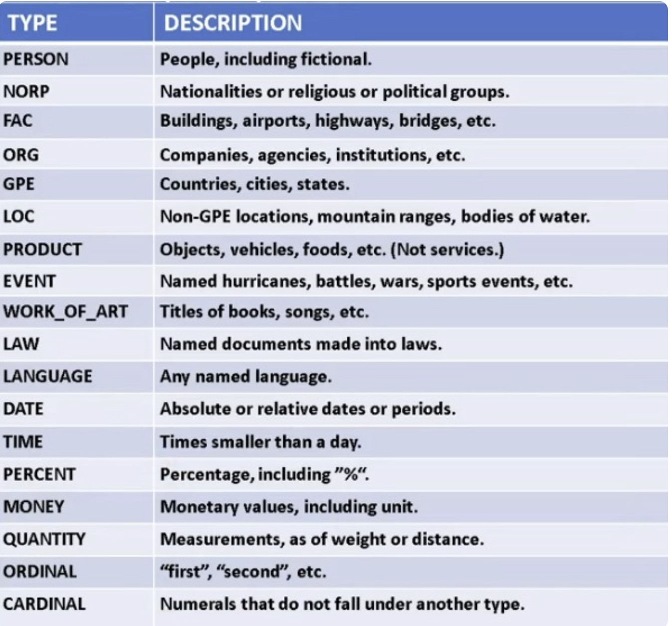
NLU tasks – Named Entities in spacy

Slide 22
NLU tasks
Sentiment Analysis: Determining the emotional tone behind a series of words to gain an understanding of the attitudes, opinions, and emotions expressed.
Here we will focus on Targeted Sentiment Classification where sentiments about specific entities/aspects which will be captured

Slide 23
NLG tasks
NLG focuses on generating natural language from a machine representation system, such as a structured database or a set of analytical results. Key tasks in NLG include:
Text Generation: Producing readable and coherent text based on some input, which can range from generating full articles on a given topic to creating summaries of long documents.
Machine Translation: Automatically translating text from one language to another, aiming to preserve the meaning and tone of the original text.
Dialogue Generation: Generating responses in a conversational context, such as in chatbots or virtual assistants, to simulate a human-like interaction.
Data-to-Text Generation: Converting structured data into natural language, such as generating weather reports from meteorological data or creating financial summaries from stock market data.
Please open NLG Tasks.ipynb notebook to go through the examples

Slide 24
NLG tasks
Content Creation: Automatically generating creative content, such as stories, poems, or music lyrics, which requires a deep understanding of both language and creativity.
Question Generation: Automatically generating questions from textual content, useful in educational settings for creating quizzes or practice tests.
Paraphrasing and Summarization: Rewriting existing text in a new form or summarizing long texts into shorter versions, maintaining the original meaning and key points.

Slide 25
NLP Tasks common to both NLU and NLG
Some NLP tasks are fundamental to both NLU and NLG, including:
Tokenization: Breaking down text into smaller units, such as words or phrases.
Stemming and Lemmatization: Reducing words to their base or root form to simplify text analysis.
Word Embeddings: Representing words in a continuous vector space to capture semantic and syntactic meanings.

Slide 26
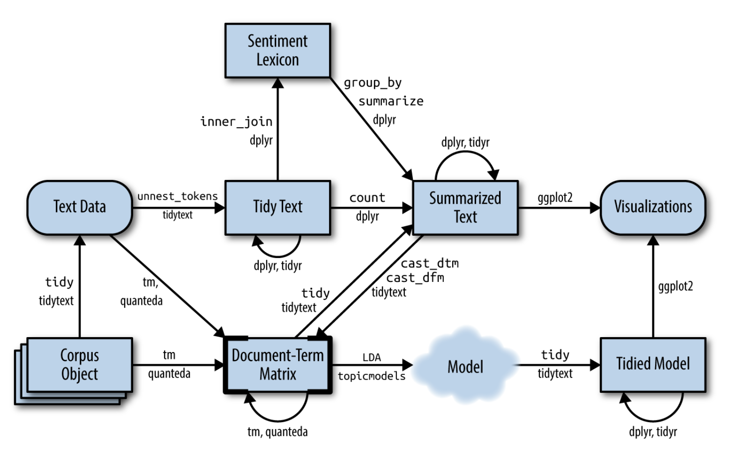
Topic Modeling
Possible routes that can be taken
when starting with Text Data

Slide 27
Topic Modeling
Topic modeling as an unsupervised machine learning technique for discovering hidden themes or topics in a collection of documents.
It has applications in text analysis, content organization, information retrieval, and exploratory data analysis.

Slide 28
Topic Modeling
Key Concepts
Topics: Sets of words that frequently co-occur and represent underlying themes.
Documents: Textual units to be analyzed (e.g., articles, reviews, social media posts).
Document-topic matrix: Representation of how much each topic contributes to each document.
Topic-word matrix: Representation of the most important words for each topic.

Slide 29
Topic Modeling
Steps in Topic Modeling
Data Preparation
Text Preprocessing
Model Training
Topic Interpretation
Evaluation (optional)

Slide 30
Important Terms to understand in Topic Modeling
Please open the file Imp_Terms_in_Topic_Modeling.R
Document-Term Matrix (DTM):
Represents word frequencies in each document.
Preprocessing steps like stop word removal and stemming are done before creating DTM.
Latent Dirichlet Allocation (LDA):
A popular topic modeling algorithm.
Models documents as mixtures of topics, and topics as mixtures of words.
Hyperparameters alpha and beta influence topic and word sparsity.
Interpreting Topics:
Examine top words for each topic using terms(lda_model).Consider domain knowledge and context for meaningful interpretation.

Slide 31
Important Terms to understand in Topic Modeling
Please open the file Imp_Terms_in_Topic_Modeling.R
Visualization:
Using Word Cloud or serVis

Slide 32
Topic Modeling
Model Training and Interpretation in R
Common topic modeling algorithms:
Latent Dirichlet Allocation (LDA)
Non-negative Matrix Factorization (NMF)
Correlated Topic Model (CTM)
Train a model using topicmodels package:
Select the number of topics (k).
Fit the model to the document-term matrix.
Interpret topics:
Examine top words for each topic using terms() function.
Visualize topic-word distributions using plot() function.

Slide 33
Latent Dirichlet Allocation - LDA
Foundation: LDA is a generative probabilistic model that assumes each document is a mixture of a small number of topics and that each word's presence is attributable to one of the document's topics.
Mathematical Approach: LDA uses Dirichlet distributions to model the topic mixtures in documents and the word mixtures in topics, providing a more nuanced understanding of document and word relationships.
Assumptions: It assumes documents are produced by a random process involving hidden variables (topics). Each topic is characterized by a distribution over all words in the corpus, and each document exhibits these topics in varying proportions.
Outcome: LDA results in two main outputs: the set of topics (each represented as a distribution over words) and the topic distribution for each document. This provides a clearer thematic structure of the corpus.

Slide 34
Latent Dirichlet Allocation - LDA
Limitations:
Choosing the optimal number of topics can be challenging and often requires domain knowledge or iterative experimentation.
LDA can also be computationally intensive for large datasets and might include topics that are not easily interpretable.

Slide 35
LDA in simple terms
Latent Dirichlet Allocation (LDA) is a statistical model that identifies topics in a collection of documents in a way that's somewhat akin to organizing a large set of fruits into different baskets based on their characteristics, even without knowing the names of the fruits beforehand.
A simplified explanation of how LDA works to identify topics based on the distribution of words across multiple documents is given below:
Assumption: LDA starts with two key assumptions.
First, each document is a mixture of various topics. Imagine each document as a fruit salad, where each piece of fruit represents a topic.
Second, each topic is characterized by a distribution of words. Think of each type of fruit having a unique combination of characteristics (color, taste, size, etc.).

Slide 36
LDA in simple terms
Random Guesses: Initially, LDA makes random guesses about which words are associated with which topics.
It's like randomly distributing a variety of fruits into baskets without knowing their actual categories.
Iterative Improvement: LDA then iteratively refines these guesses based on two intuitive ideas:
If a particular word appears frequently in a document, it's likely important to that document's topics. For instance, if "apple" appears often in a document, it might suggest the presence of a "Fruit" topic.
If a particular word appears frequently in a topic across many documents, it's likely important to that topic. If "apple" is common in what we're guessing is the "Fruit" topic, it strengthens the association of "apple" with this topic.

Slide 37
LDA in simple terms
Reassignment: During each iteration, LDA reassigns words to topics based on the likelihood of the word belonging to a topic, considering the document's topic mixture and the word's association with topics across all documents. It's akin to continuously rearranging fruits into baskets where they fit best, based on their characteristics and the overall composition of each basket.
Convergence: This process continues until the assignments of words to topics and the mixtures of topics in documents stabilize. The result is a set of topics where each topic is a collection of words that frequently occur together, and each document is represented as a mixture of these topics.
Outcome: The end result is that LDA can tell us the topic mixtures in each document (e.g., Document 1 is 70% about "Fruit" and 30% about "Health") and the word mixtures in each topic (e.g., the "Fruit" topic is characterized by words like "apple", "banana", "orange").

Slide 38
LDA in simple terms
In essence, LDA is like a sophisticated sorting process that groups words into topics based on their distribution across documents, and then describes each document as a blend of these topics, all without any prior knowledge about the words or topics.
This makes LDA a powerful tool for uncovering the hidden thematic structure in large collections of text.

Slide 39
What is latent in LDA ?
In Latent Dirichlet Allocation (LDA), the term "latent" refers to hidden or unseen variables. More specifically, it emphasizes that:
Topics are inherently hidden: We can't directly observe the topics in a document; we can only infer them based on the words used.
Document-topic and topic-word distributions are hidden: We don't directly know how much each topic contributes to a document or how likely each word belongs to a specific topic. LDA estimates these hidden probabilities.
Using a "latent" approach allows LDA to model the underlying thematic structure of a document collection without requiring pre-labeled data or explicit definitions of topics.
LDA learns these topics automatically based on the observed word distributions.

Slide 40
Analogy
Imagine a bag of fruits containing apples, oranges, and bananas.
We can see the fruits (words), but we can't directly see the categories (topics) they belong to (e.g., red fruits, citrus fruits).
LDA helps us discover these hidden categories based on the observed occurrences of different fruits.
Understanding the "latent" aspect is crucial for interpreting LDA results correctly.
The topics we extract are estimates based on the model's learning process, and they may not perfectly reflect the true underlying themes in your data.
It's important to critically evaluate and refine these topics based on the domain knowledge and specific goals.

Slide 41
Example in R
Please open file lda_latent.R

Slide 42
What is Dirichlet Distribution?
The Dirichlet distribution is a family of continuous multivariate probability distributions parameterized by a vector of positive reals.
It plays a central role in Latent Dirichlet Allocation (LDA) by modeling the uncertainty and variability in the composition of topics within documents and the distribution of words within topics.
It's a multivariate generalization of the Beta distribution, ideal for modeling proportions that sum to 1, making it suitable for probabilities.

Slide 43
What is Dirichlet Distribution?
In the context of Latent Dirichlet Allocation (LDA), the Dirichlet distribution is crucial for two main reasons:
Document-Topic Distribution:
LDA assumes that the mixture of topics in each document follows a Dirichlet distribution.
The parameters of this distribution (often denoted by alpha, α) control the sparsity or density of topic distribution in documents.
A higher alpha value suggests that documents are likely to contain a mixture of most topics, whereas a lower value indicates that a document is likely to be dominated by fewer topics.

Slide 44
What is Dirichlet Distribution?
2) Topic-Word Distribution:
Similarly, LDA assumes that the distribution of words in each topic also follows a Dirichlet distribution.
The parameters of this distribution (often denoted by beta, β) influence the word distribution within topics.
A higher beta value suggests that topics will contain a broader mixture of words, while a lower value indicates that topics will be more specific or focused on fewer words.

Slide 45
Why Dirichlet Distribution?
The Dirichlet distribution is relevant to text data because it allows for a flexible and probabilistic foundation to model the latent thematic structures in a corpus.
It accommodates the intuition that documents cover a limited set of topics and that topics often include a limited set of words.
Please open file lda_Dirichlet1.R

Slide 46
Mathematical basis of LDA
Probabilistic Model: LDA views a collection of documents as a product of a generative process involving hidden topics.
Dirichlet Distribution: It assumes a Dirichlet prior for both topic distributions over words and document distributions over topics, ensuring non-negative probabilities that sum to 1.
Generative Process:
For each document:
Choose a distribution over topics θ from a Dirichlet distribution with parameter α.
For each word in the document:
Choose a topic z from the document's topic distribution θ.
Choose a word w from the topic's word distribution φ (also drawn from a Dirichlet with parameter β).
Key Parameters:
α: Controls the topic distribution sparsity. Higher α values lead to more even topic distributions across documents.
β: Controls the word distribution sparsity. Higher β values encourage more diverse words within topics.

Slide 47
Key Features of LDA
Mathematical Basis: LDA is a probabilistic, generative model based on Bayesian statistics.
Interpretability: LDA provides an intuitive interpretation of topics as distributions over words
Handling of Polysemy and Synonymy: LDA can handle polysemy(single word has multiple related meanings) more effectively by assigning different meanings to different topics
Scalability and Complexity: LDA is generally more computationally intensive due to its iterative inference process

Slide 48
Topic Modeling
Visualization in R
Document-topic distributions: Showing how topics are distributed across documents serVis
Word clouds: Visualizing top words for each topic using wordcloud package.
Topic heatmaps: Displaying topic-word probabilities using heatmap() function.

Slide 49
Example to work out
Open file lda_heatmap.R and start building out the code
A starter code has already been provided

